Slide 1



Criminal Justice
Explore a Major
“Educating the next generation of criminal justice leaders”

Slide 2
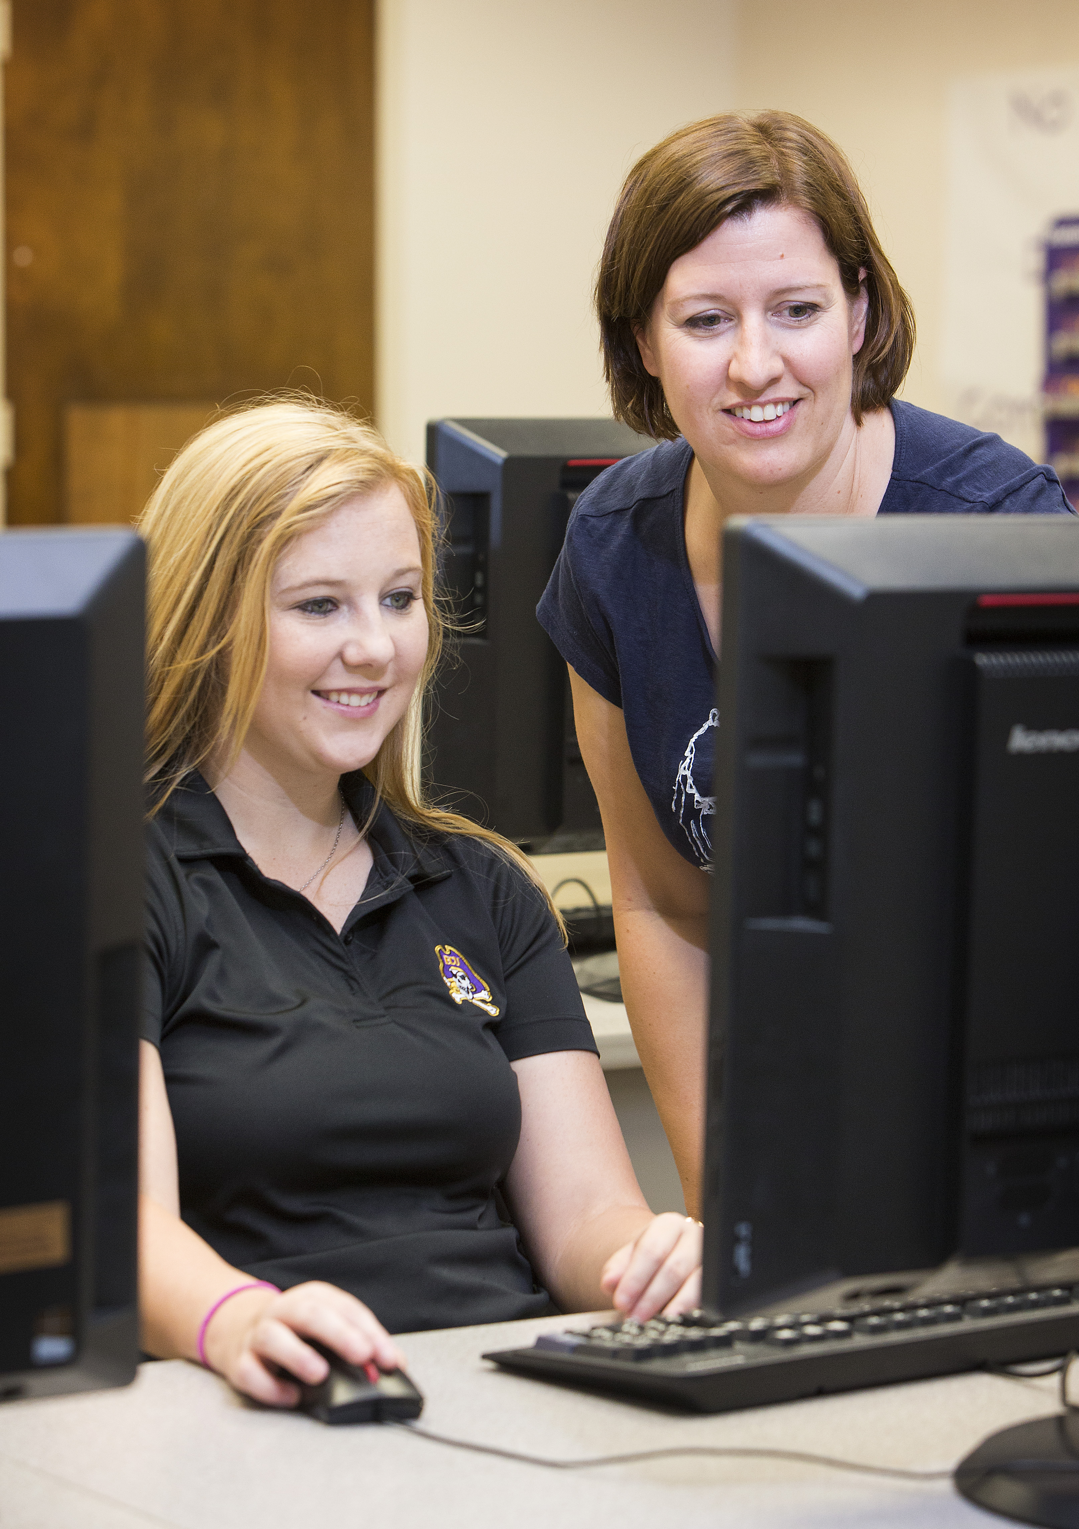
Criminal Justice Academics

Slide 3
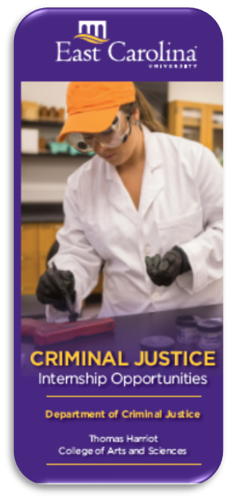
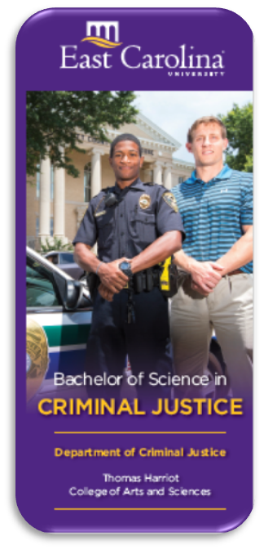
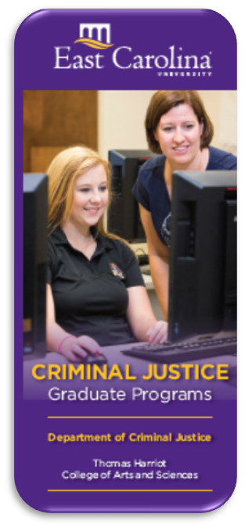
Academic Programs

Slide 4
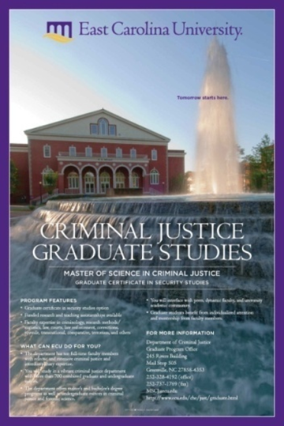
Academic Degrees and Programs
Undergraduate Programs
  Bachelor of Science in Criminal Justice
  Minors
    Criminal Justice
    Forensic Science
    Criminal Law and Legal Process
  Graduate Programs
  Master of Science in Criminal Justice
  Graduate Certificate options
      Criminal Justice Education
      Public Management and Leadership
      Security Studies

Slide 5
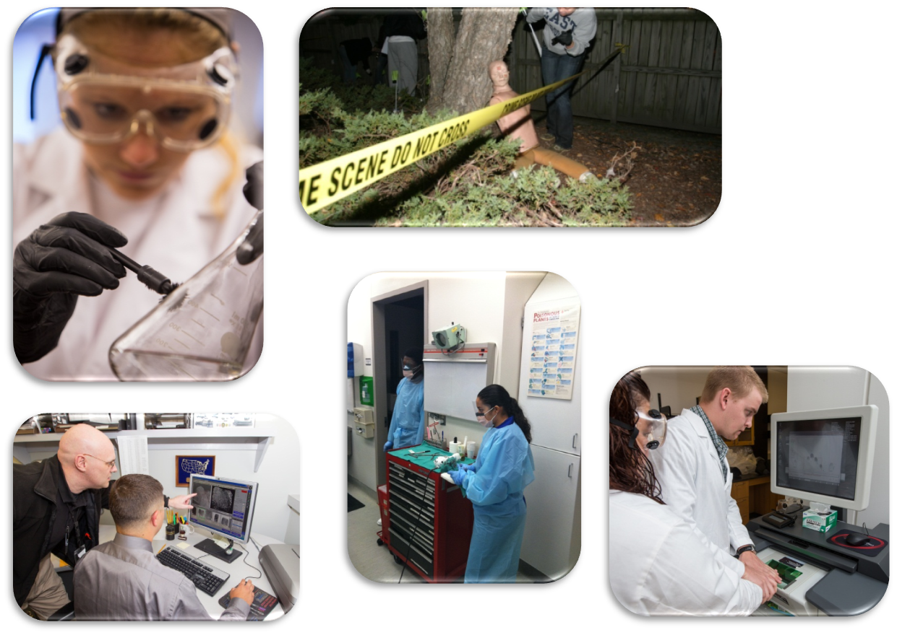
Forensic Science Studies
Classroom
Laboratory
Crime Scene
CJ Agency

Slide 6
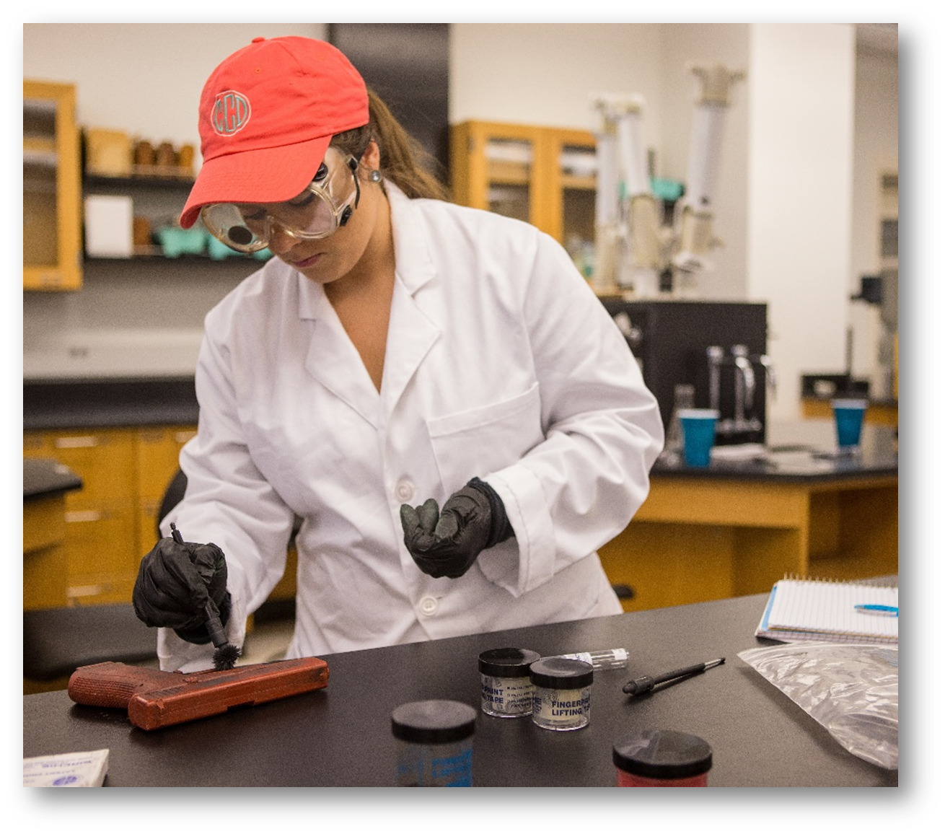
Forensic Science at ECU

Slide 7

Other Criminal Justice Minors
Minor in Criminal Justice
Minor in Criminal Law and Judicial Process

Slide 8
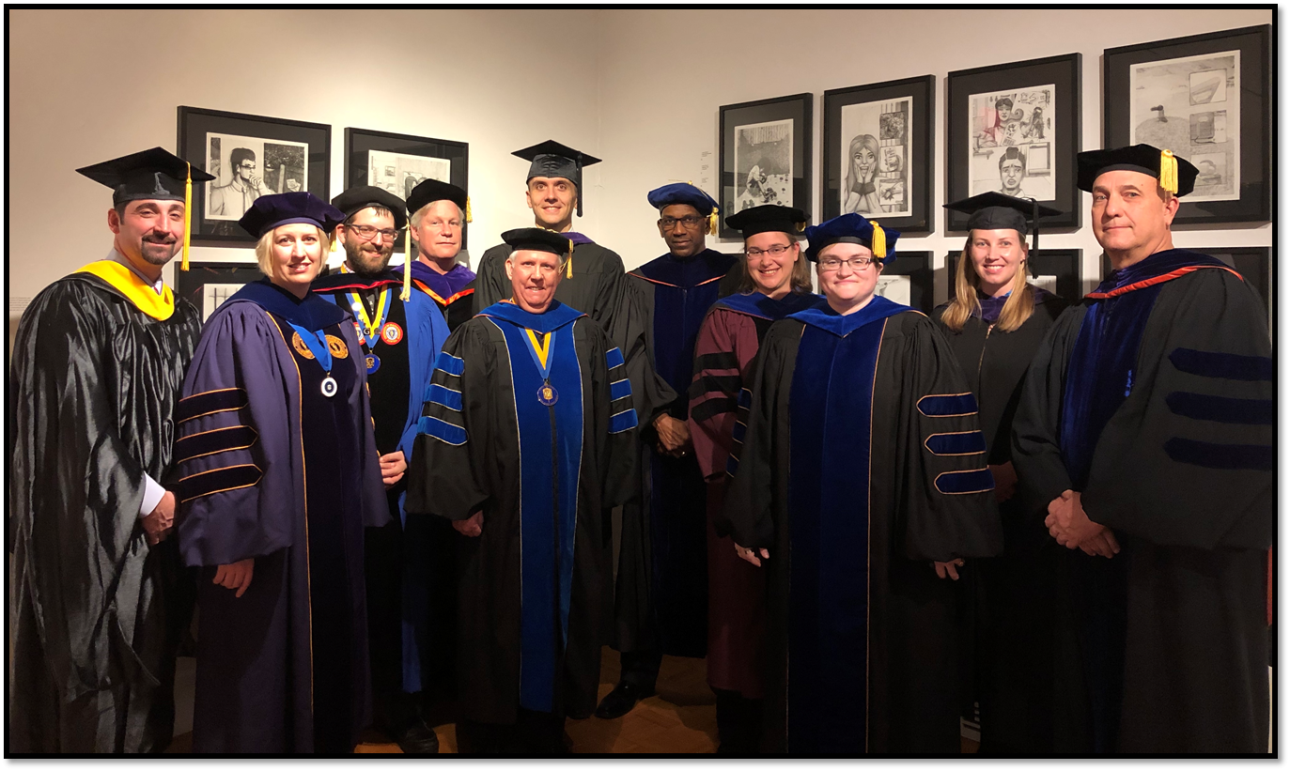
Faculty Facts

Slide 9




Departmental Research
International
United Nations South Sudan Crime Scene Training
National
National Capital Jury Project
National Domestic Violence Homicide Risk Project
North Carolina
North Carolina Mental Health Task Force
North Carolina Correctional Personnel Study
Local
Greenville Community Police Satisfaction Study
Wake County Drug Court Project

Slide 10
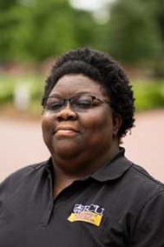
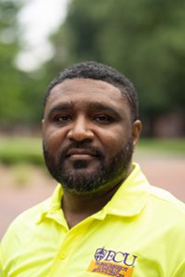
Student Advising
Mrs. Peggy Newsome
Mr. Courtney Rosemond

Slide 11

Learning Beyond the Classroom
Internship and field experience
Criminal Justice study abroad
International study & student exchange
Faculty-student research
Agency visits
Guest speakers and symposia
Career Fair programs
Community engagement
Service learning

Slide 12
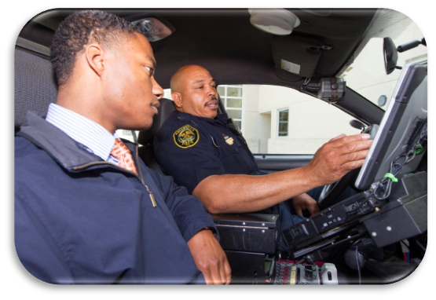
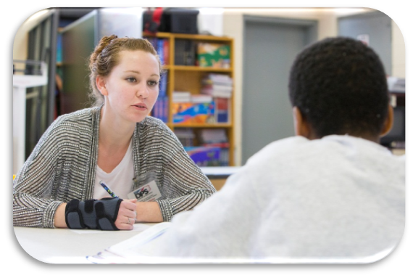
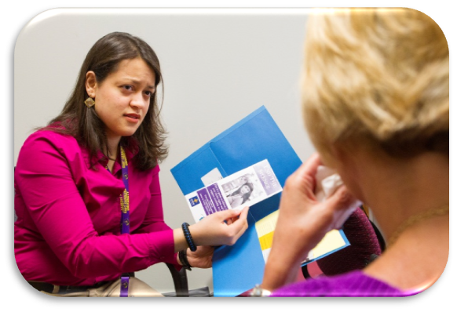
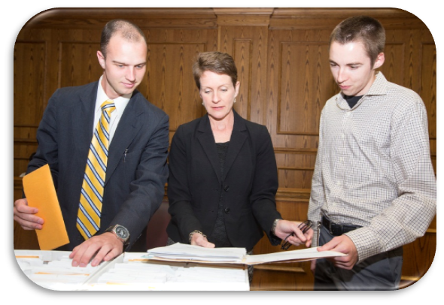
Field Experience/Internship
Law Enforcement • Court • Probation • Juvenile • Victim Advocate • Law Office

Slide 13
Agency Internship Experience
Offered Spring, Summer, and Fall.
Work with law enforcement, law, courts, corrections, and social service agencies.
Opportunities available in local, state, national and even international organizations!

Slide 14
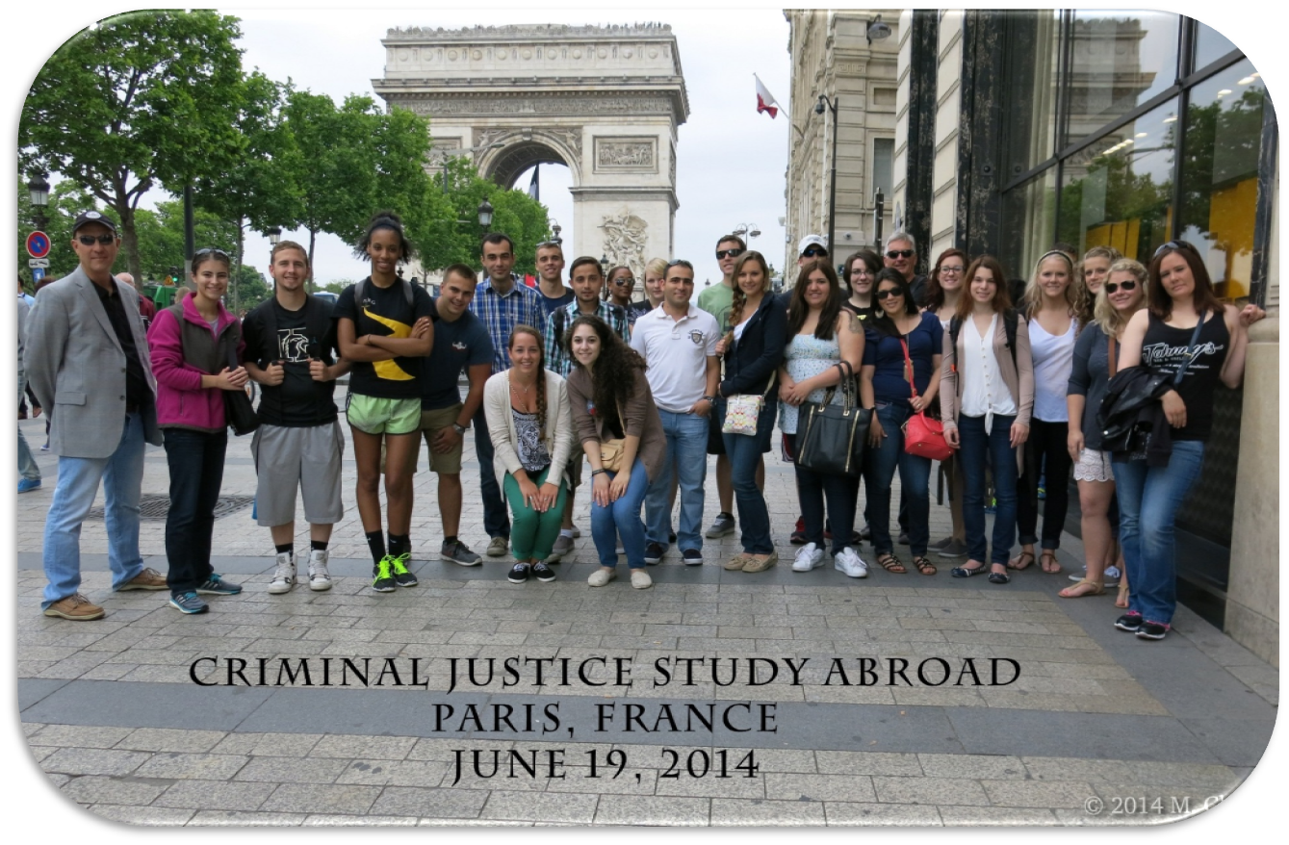
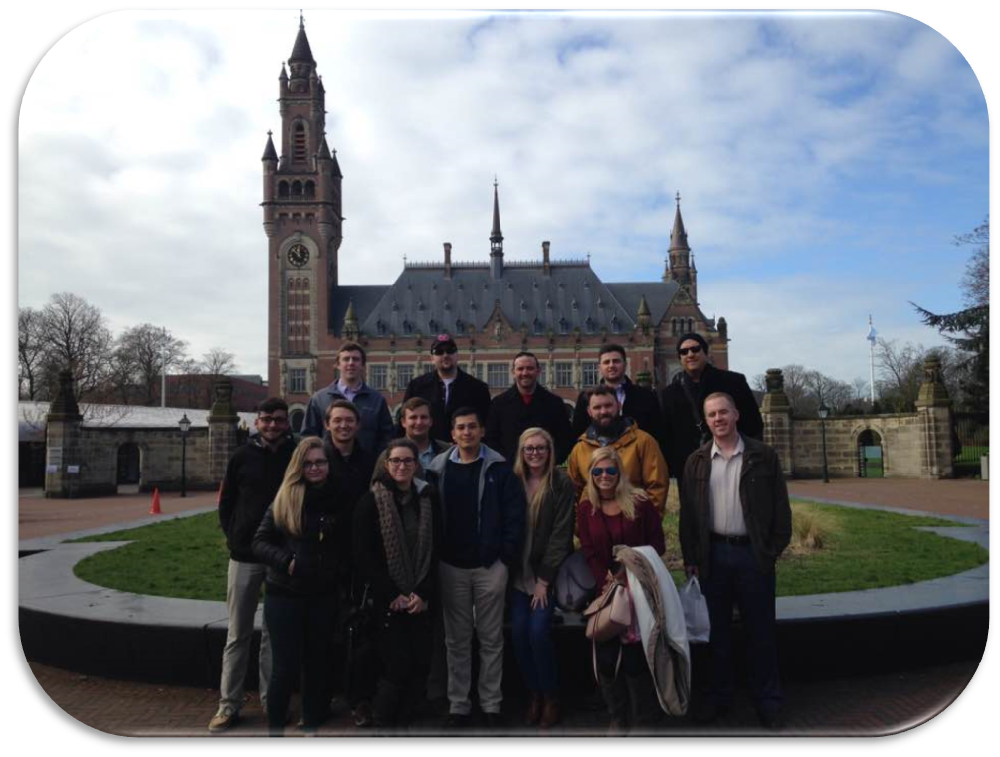
Study Abroad in Europe
Paris
The Netherlands

Slide 15
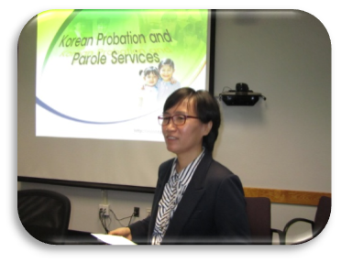

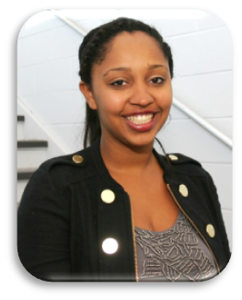
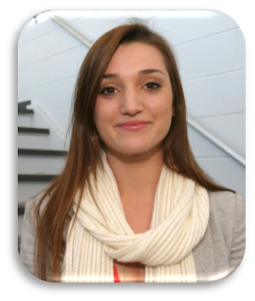

International Study
Visiting Scholar
Director Sun-OK Shim: South Korean Ministry of Justice
Foreign student exchange program
La Trobe University
Australia
University of Manchester
United Kingdom

Slide 16
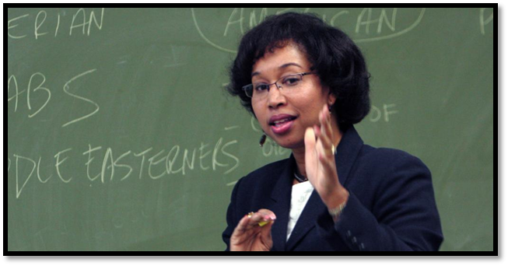
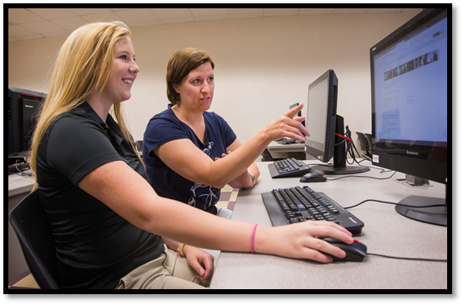
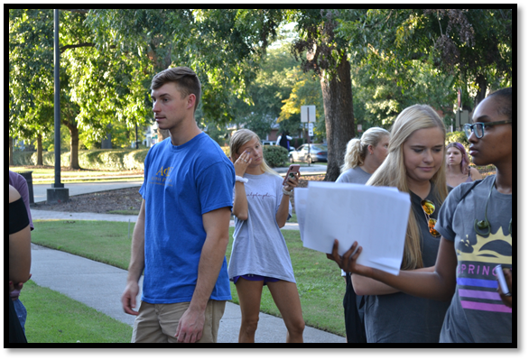
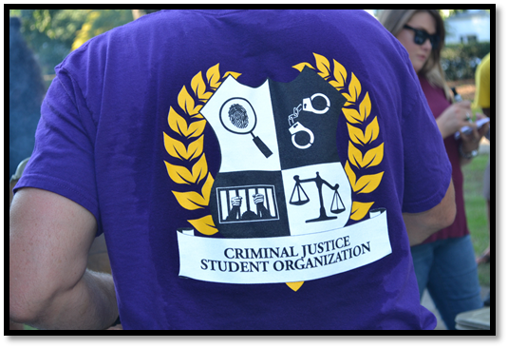
Student Life

Slide 17
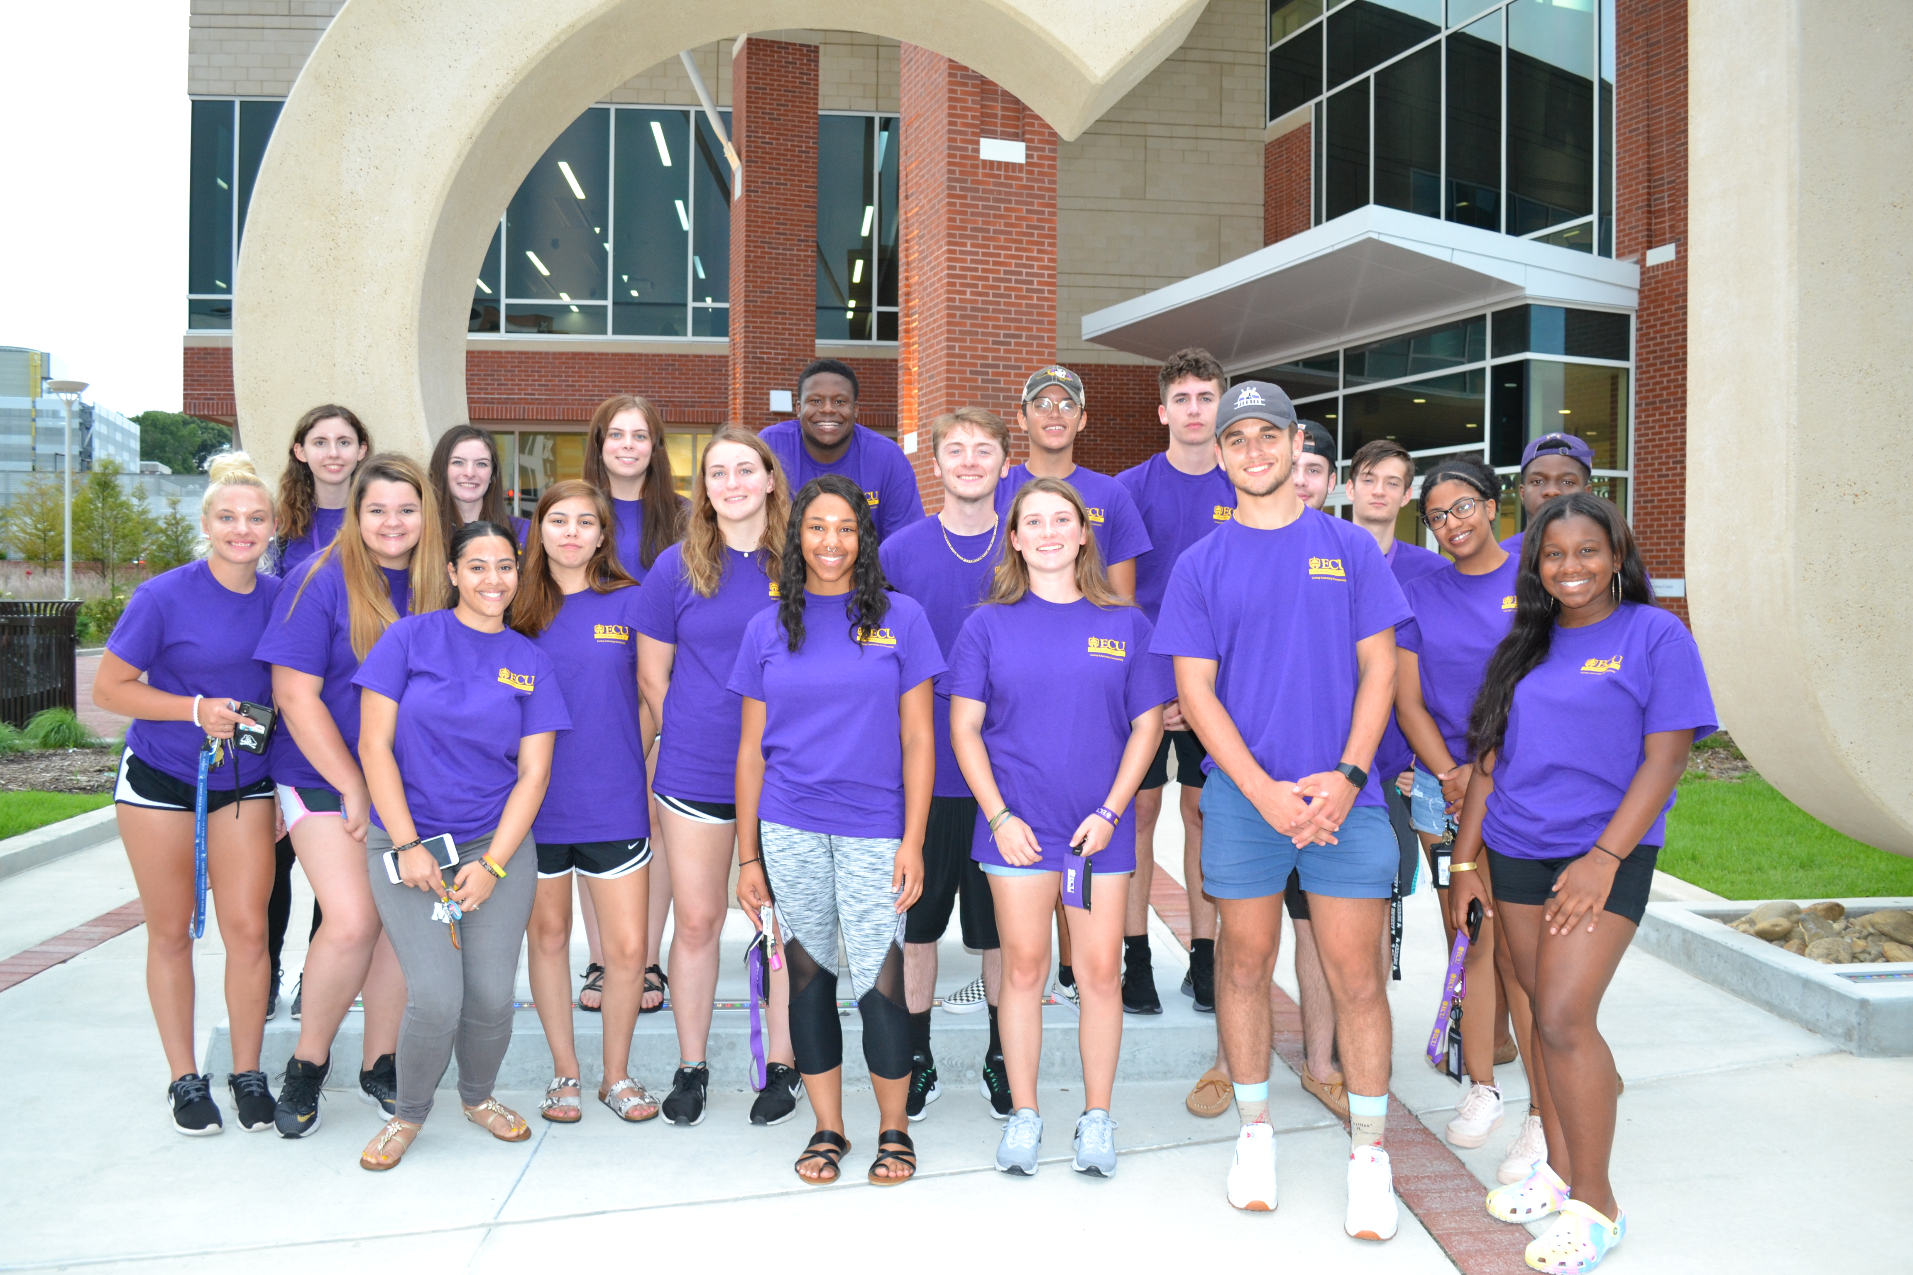

Living-Learning Community
First-year Criminal Justice students
20 student cohort group
Living in Umstead Residence Hall
CJ-LLC support team consists of:
  CJ academic advisors
  CJ faculty mentors
  Subject matter tutors
Academic support; extra-curricular programming; career networking
Creates a community learning experience that facilitates student university transition, academic success, peer networking, and familiarity with the criminal justice field.

Slide 18
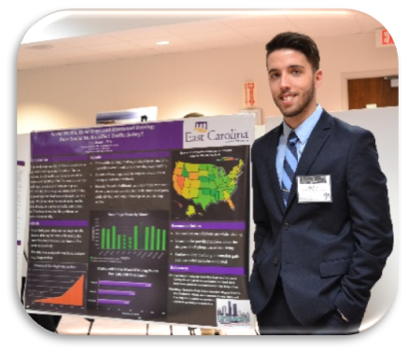
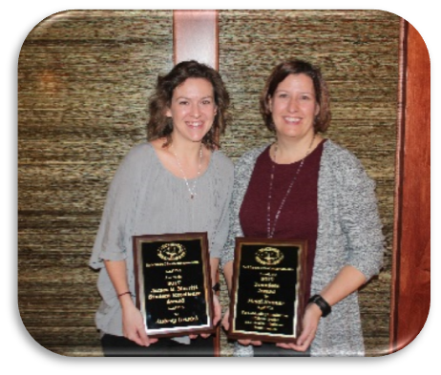
Faculty-Student Research
Toby Board
Graduate Research Assistant
2018 Lifesavers Traffic Safety
Scholar
Aubrey Urwick
MSCJ graduate student
2017 James B. Merritt
Outstanding Graduate Student Award
North Carolina Criminal Justice Association

Slide 19
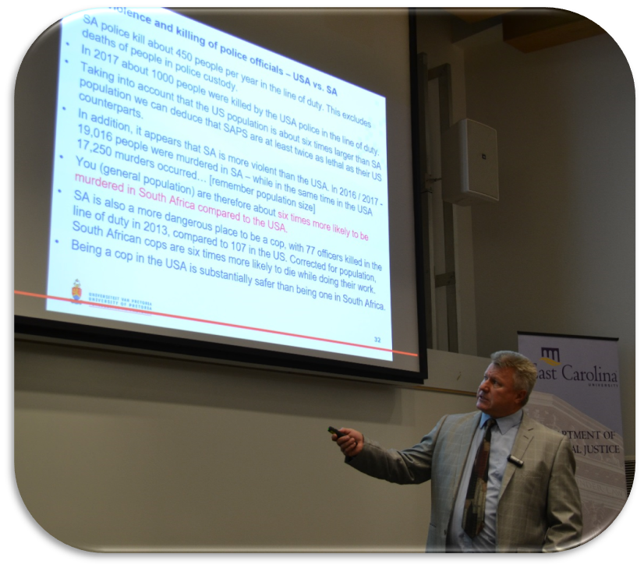

Expert Guest Speakers and International Scholars
Professor Christiaan Bezuidenhout
University of Pretoria
South Africa
2018
International Criminology Lecture

Slide 20
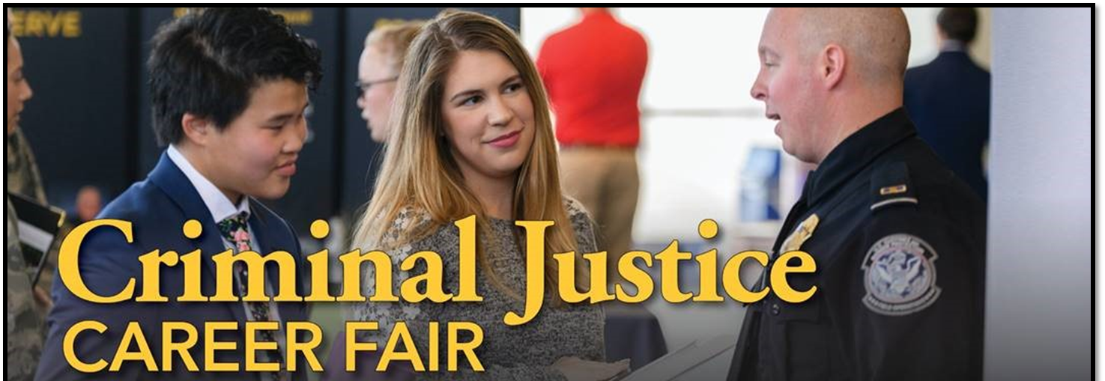
Annual Criminal Justice Career Fair
40+ Federal, State, and Local Criminal Justice Agency Participants
North Carolina Law Schools

Slide 21
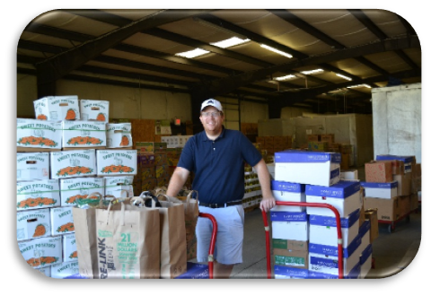
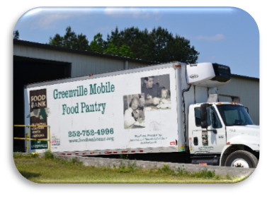
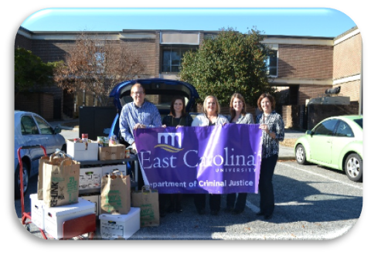
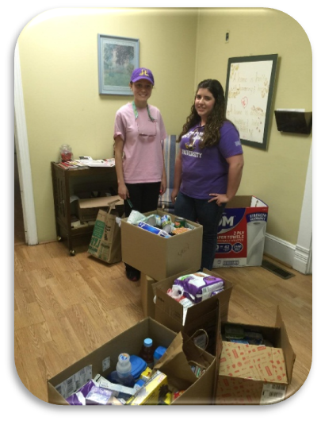
Community Engagement
Faculty-student food drive donated
2,250 lbs. to the food bank of
Central & Eastern North Carolina
Criminal Justice Student Organization coordinated donations for the Greenville Domestic Violence Shelter

Slide 22
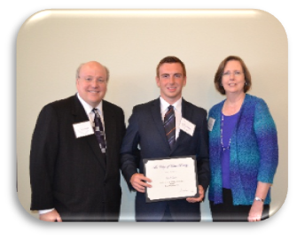
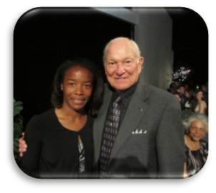
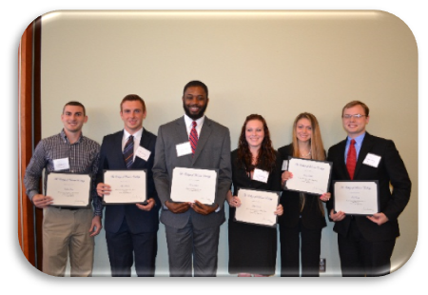
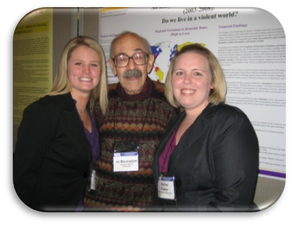
Scholarship and Assistantship
Scholarships
Criminal Justice Advisory Board
Nancy Darden
John F. Minges III
Roger D. Sharpe
David & Willa Stevens
Practical Solutions for Justice
Graduate Assistantships
Graduate Research Assistant

Slide 23
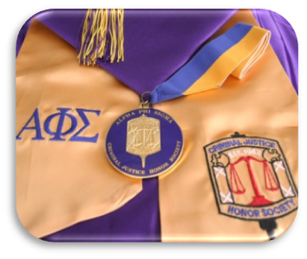

Student Organizations
Alpha Phi Sigma (Ωmega Alpha chapter)
National Criminal Justice Honor Society
- National academic standards
Criminal Justice Students Organization
- Available to all criminal justice
majors/minors

Slide 24
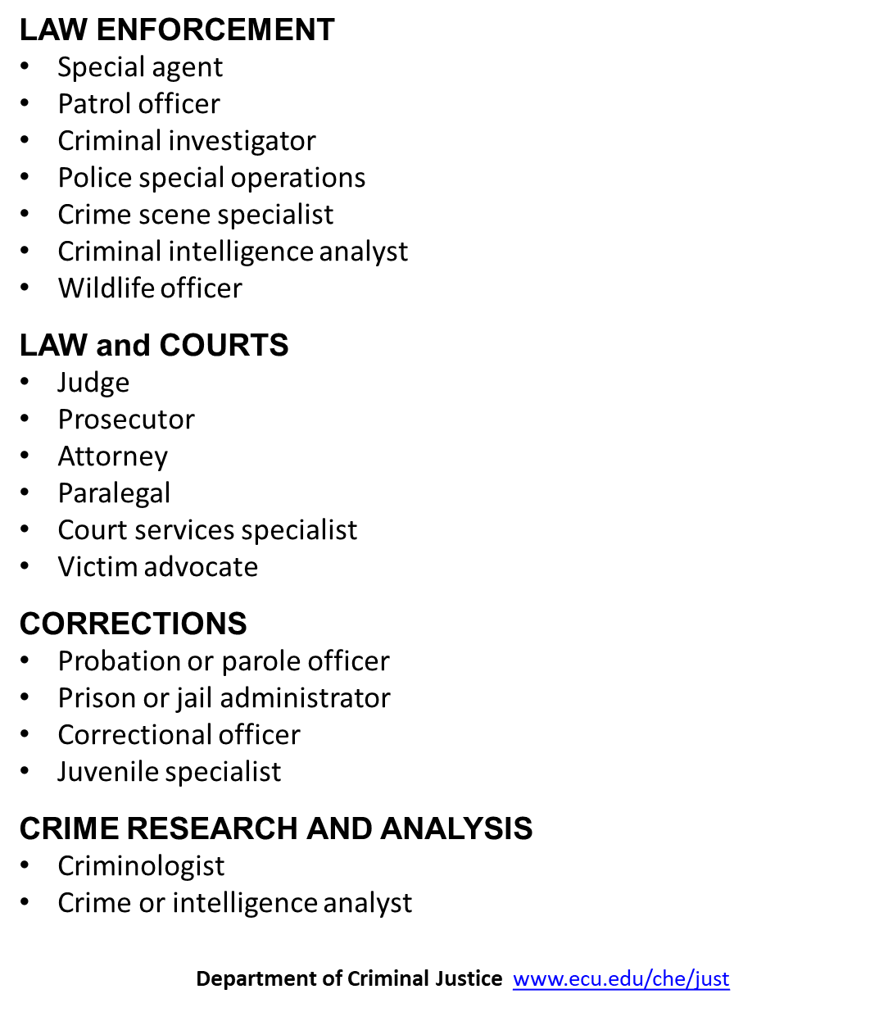
Careers in Criminal Justice

Slide 25
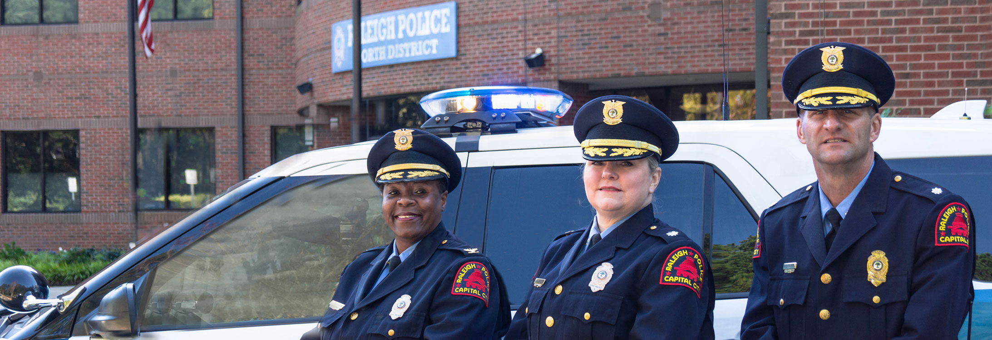
Distinguished Alumni

Slide 26
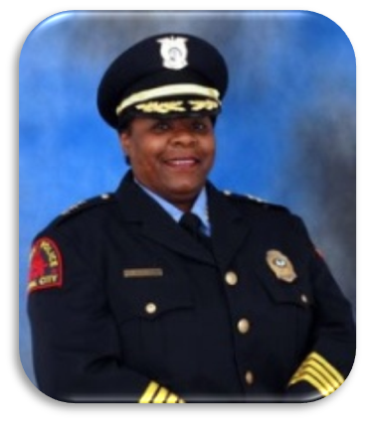
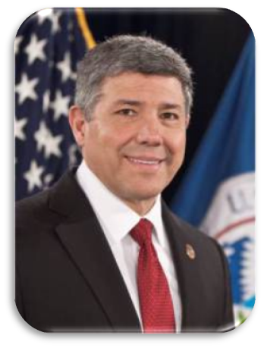
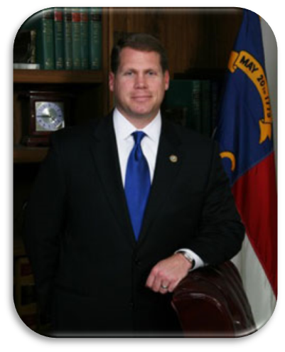
Distinguished Alumni
Law Enforcement
Chief Cassandra Deck-Brown
Raleigh Police Department
Richard Chavez
Operations Director
US Dept. of Homeland Security
Sheriff Asa Buck
Carteret County NC

Slide 27
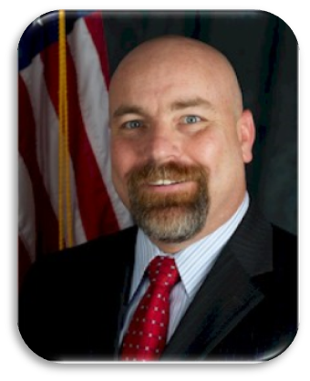
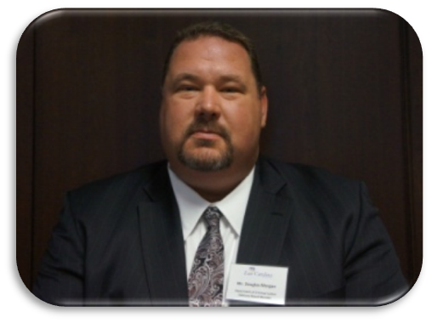
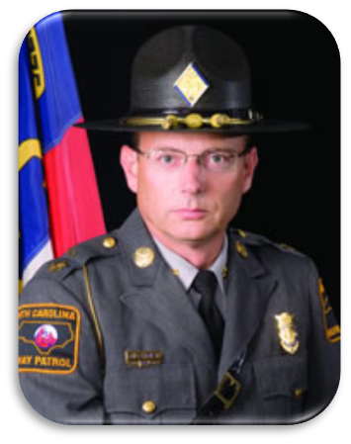
Distinguished Alumni
Law Enforcement
Carl Caulk
Assistant Director
US Marshals Service
Douglas Morgan
Special Agent in Charge
Office of Investigations
National Science Foundation
Michael Gilchrist Commander
North Carolina State Highway Patrol

Slide 28
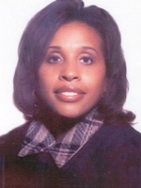
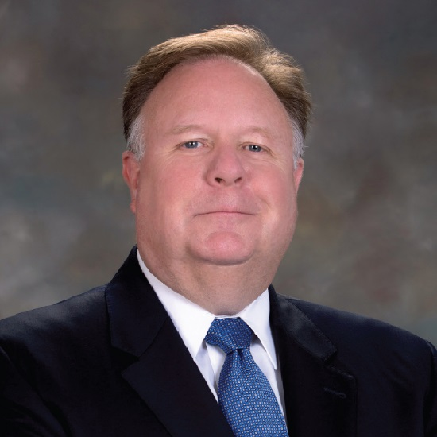
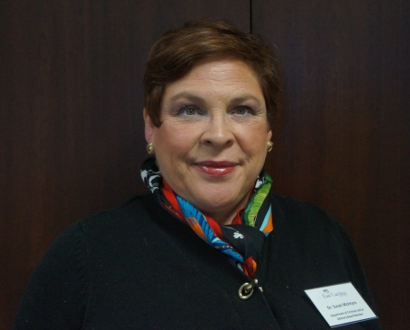
Distinguished Alumni
Law and Courts
Hon. Regina Parker
Chief District Court Judge
Hon. Jeffrey Foster
Superior Court Judge
Susan McIntyre
Attorney at Law

Slide 29
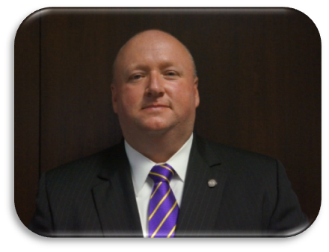
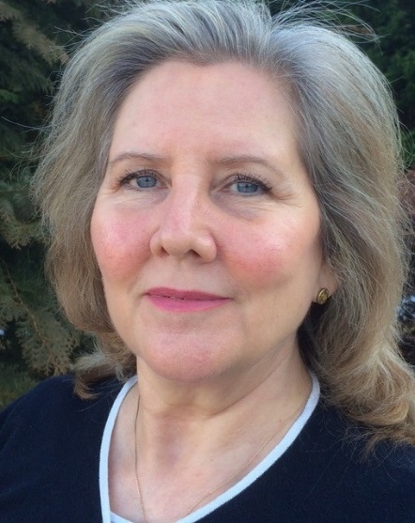

Distinguished Alumni
Corrections
Lee Meeks
US Probation Officer
Federal Judicial District
Karen Albert
Correctional Administrator
Arthur Beeler
Warden
Federal Bureau of Prisons

Slide 30

We are Criminal Justice

Slide 31

Welcome Aboard

